Slide 1
Indium vs Uranium calibration
MK 19/10/2015
MK 28/02/2016

Slide 2
Indium vs Uranium calibration
MK 19/10/2015

Slide 3
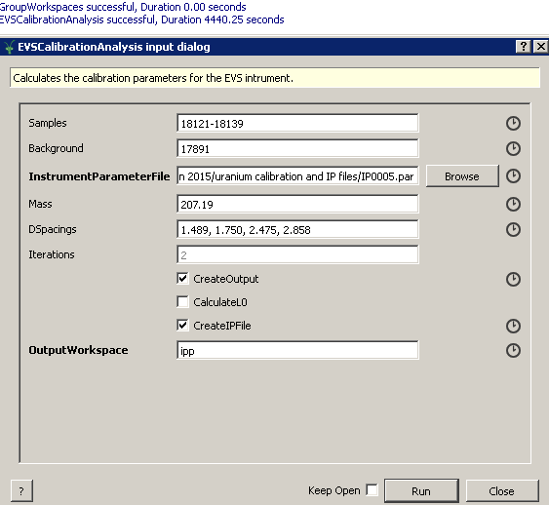
Indium-based calibration
19/10/2015

Slide 4
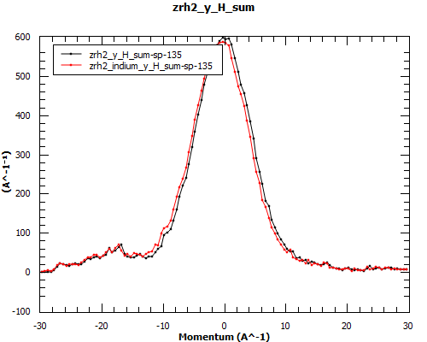

Slide 5
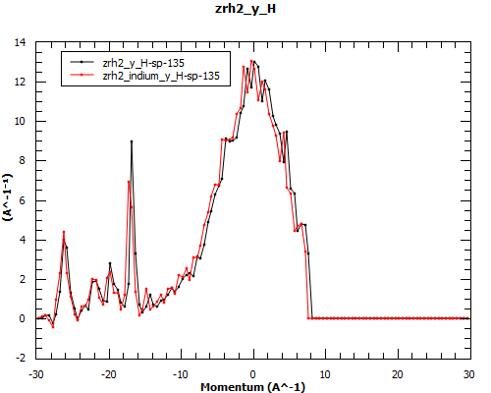

Slide 6
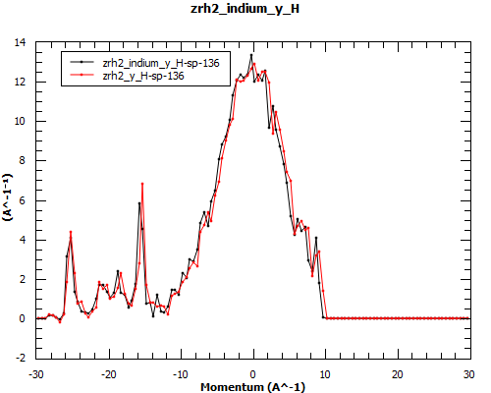

Slide 7
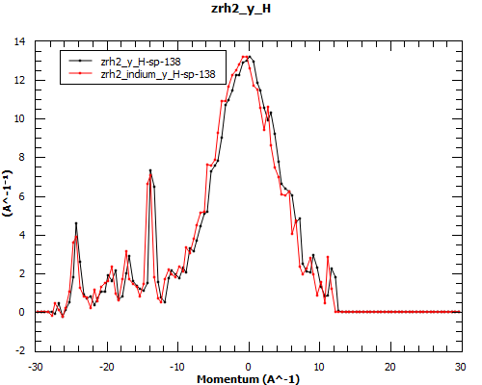

Slide 9
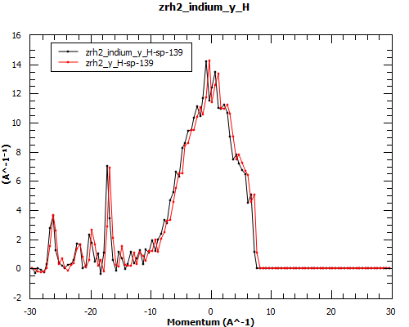

Slide 10
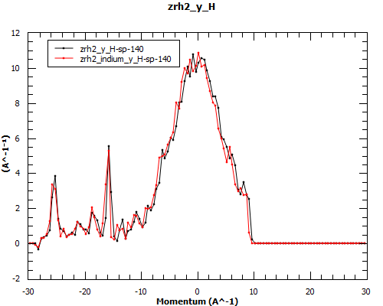

Slide 11
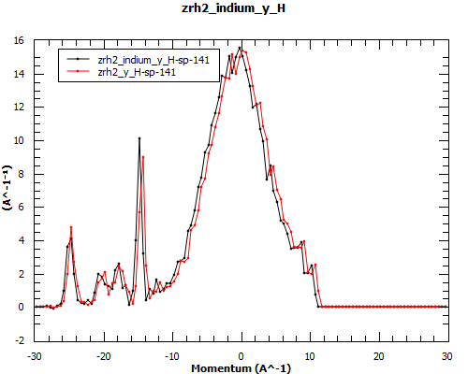

Slide 12
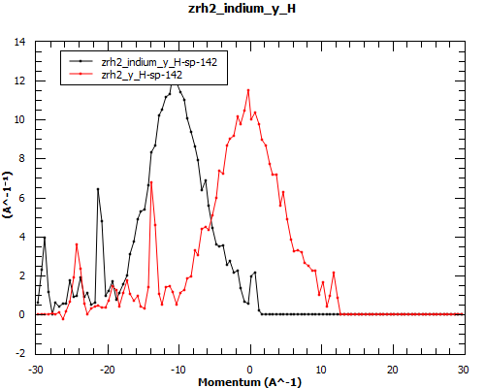

Slide 13
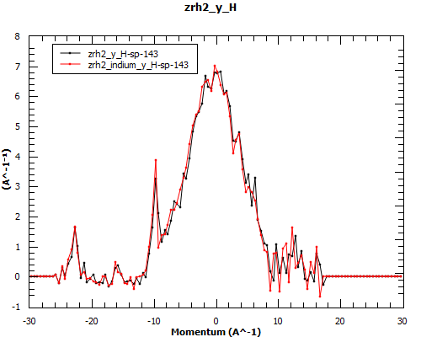

Slide 14
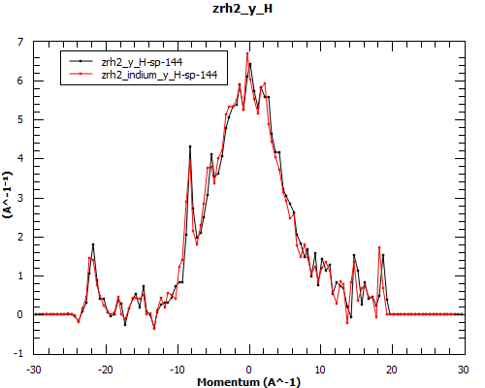

Slide 15
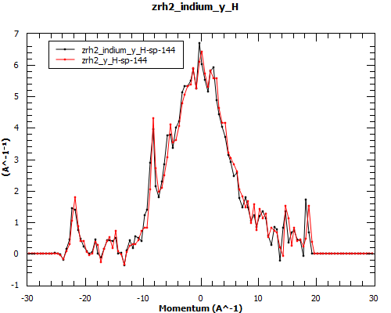

Slide 16
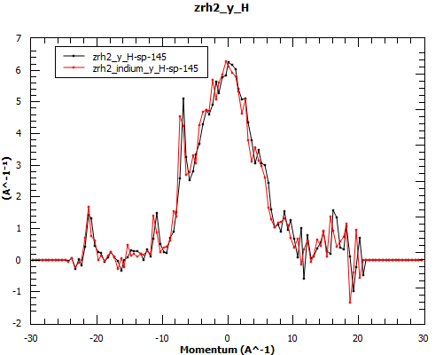

Slide 17
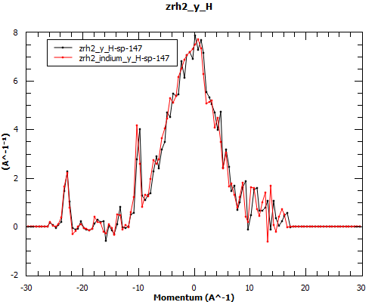

Slide 18
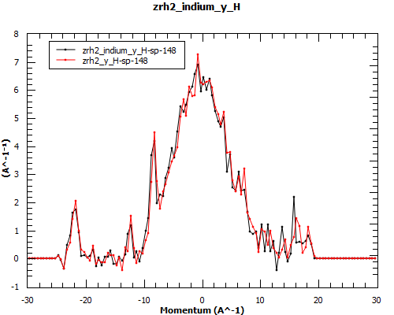

Slide 19
t0 values comparison

Slide 20
LO values comparison

Slide 21
L1 Survey offest

Slide 22
theta survey offset

Slide 23
E1 IPSurvey offset

Slide 27
Indium-based calibration
28/02/2016

Slide 28
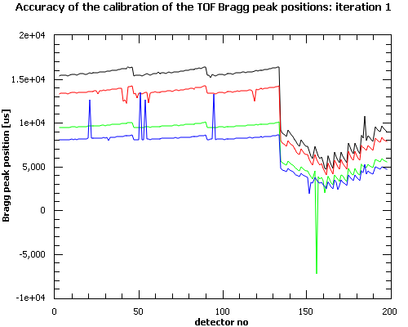
Angular calibration based on positions of 4 lead Bragg peaks:
Accuracy of the calibration of the Bragg peak positions based on d-spacings
only and no PeakFinder

Slide 29
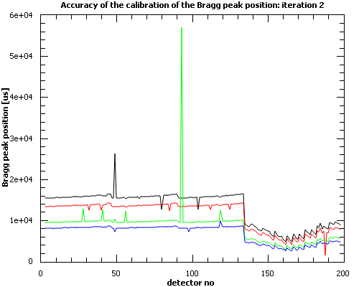
Angular calibration based on positions of 4 lead Bragg peaks:
Accuracy of the calibration of the Bragg peak positions based on d-spacings
only and no PeakFinder

Slide 30
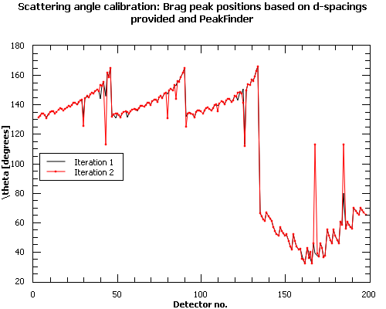

Slide 31
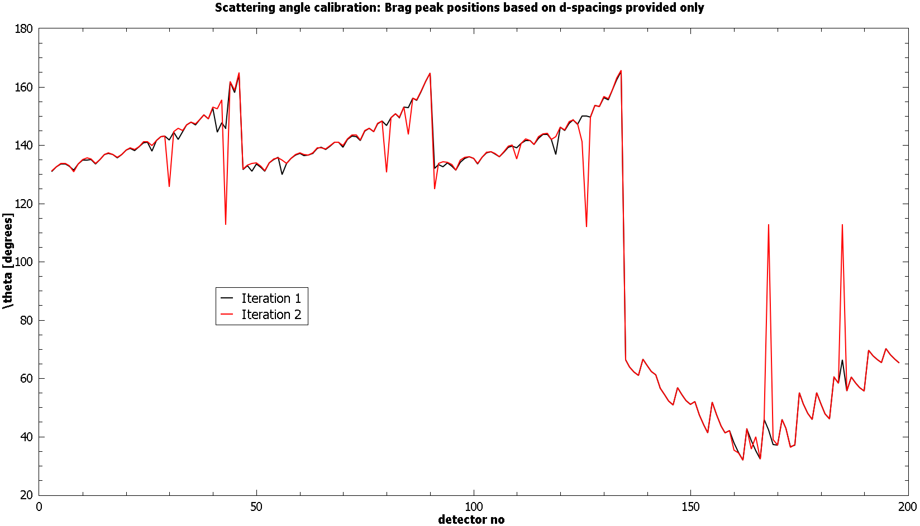

Slide 32
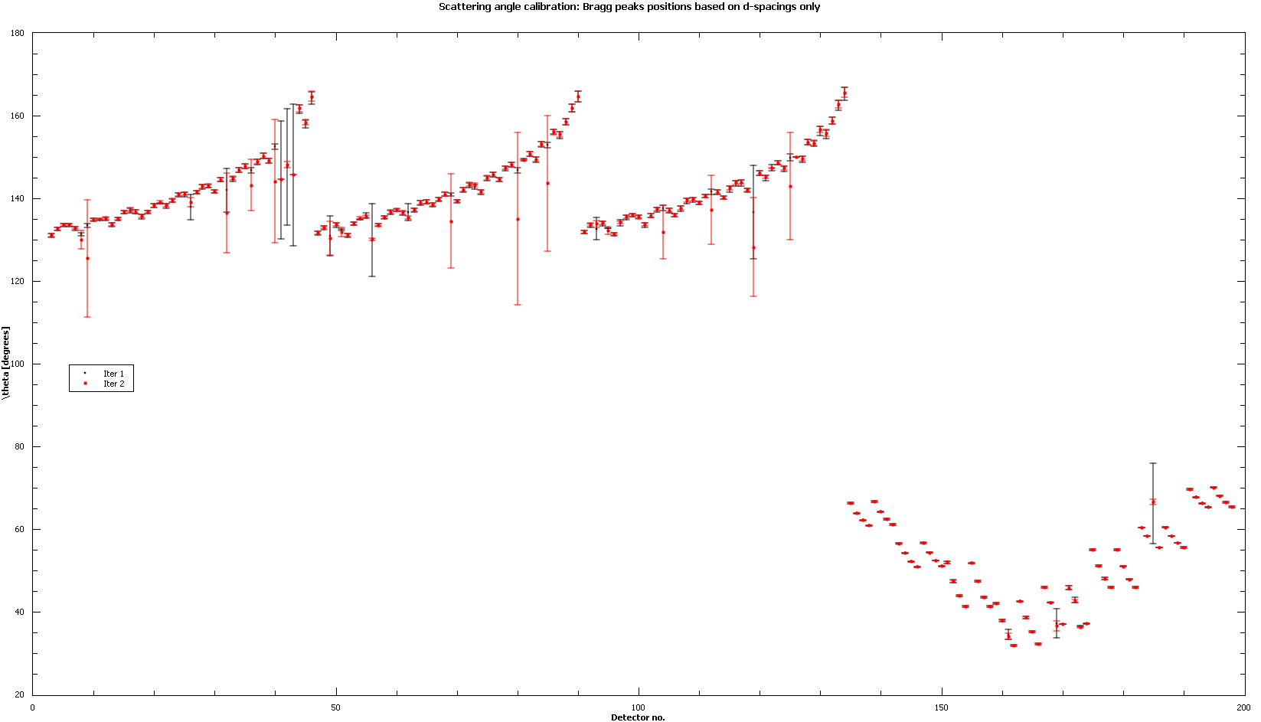

Slide 33
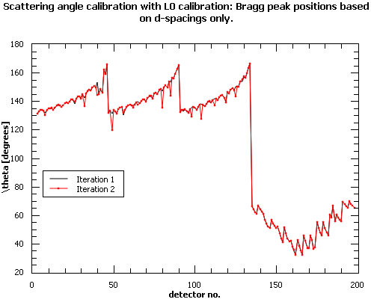

Slide 34
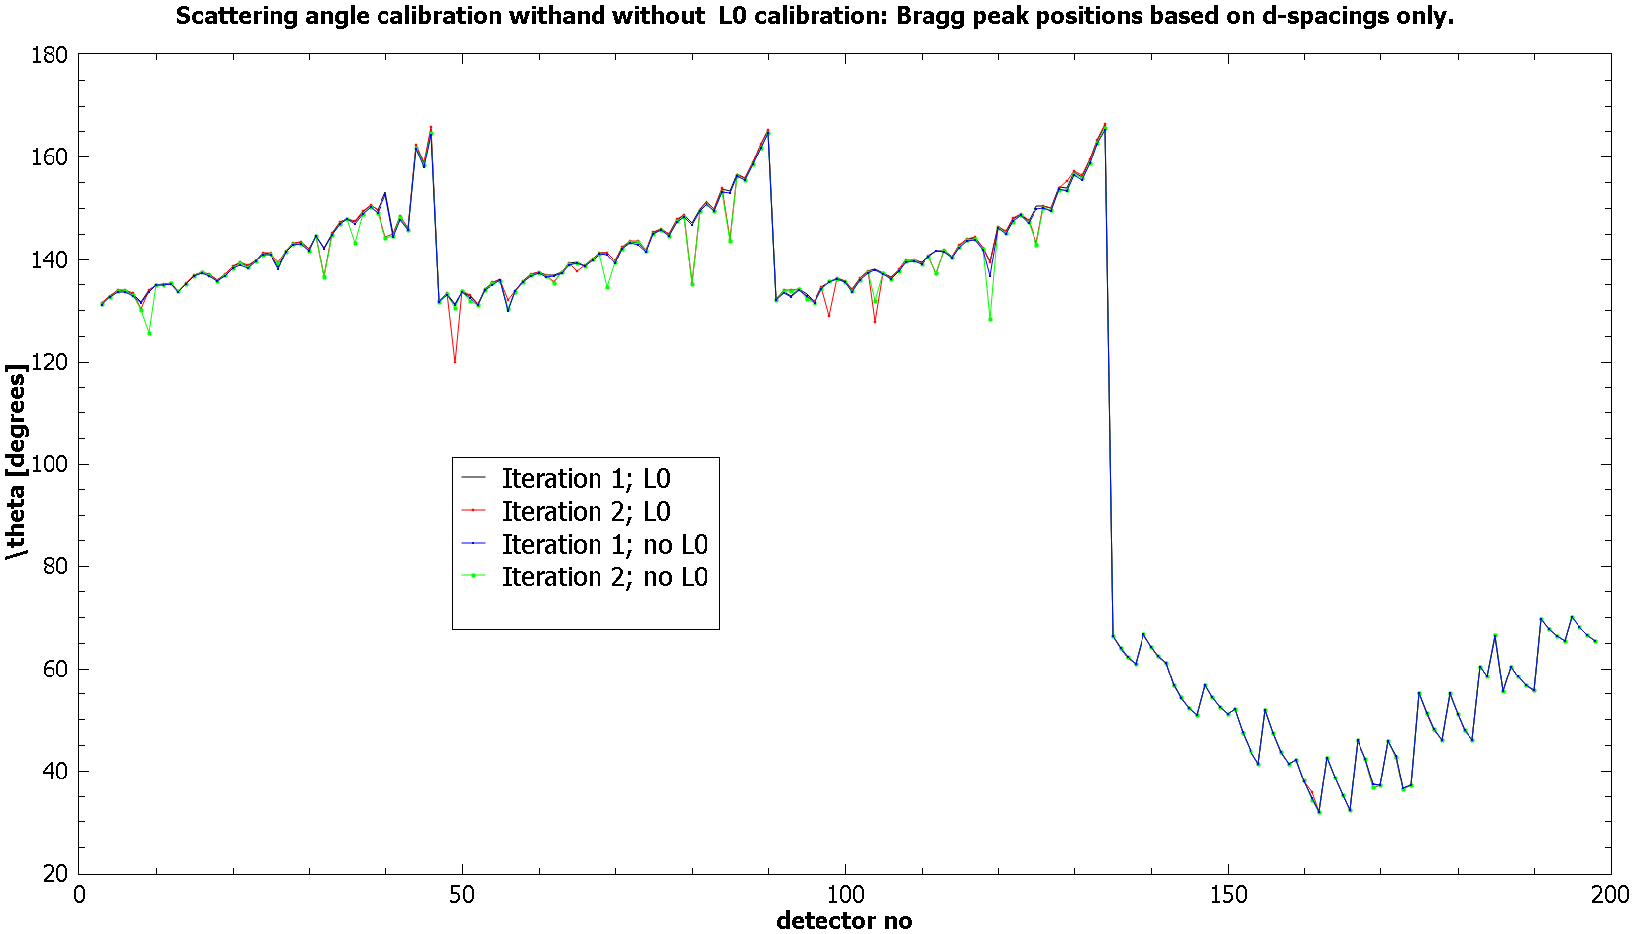

Slide 35
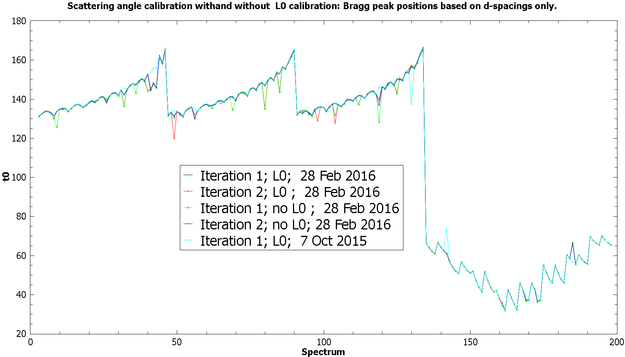

Slide 36
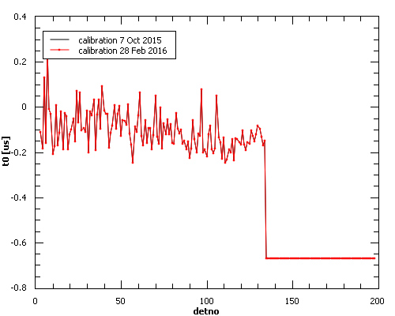

Slide 37
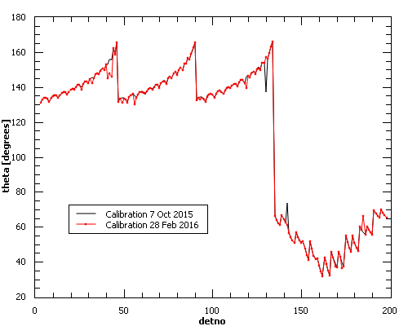

Slide 38
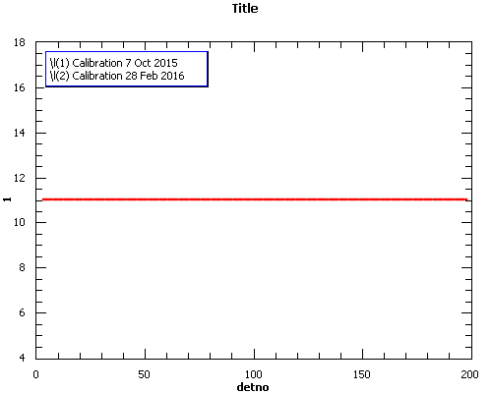

Slide 39
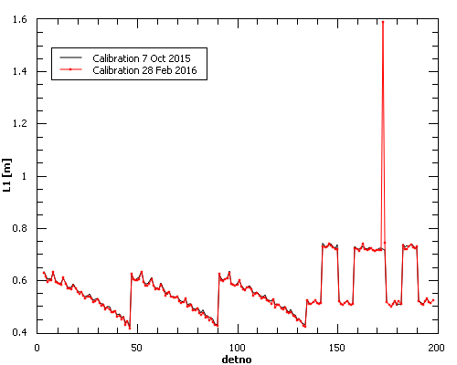

Slide 40
Comparison of indium-based and uranium-based calibration

Slide 41
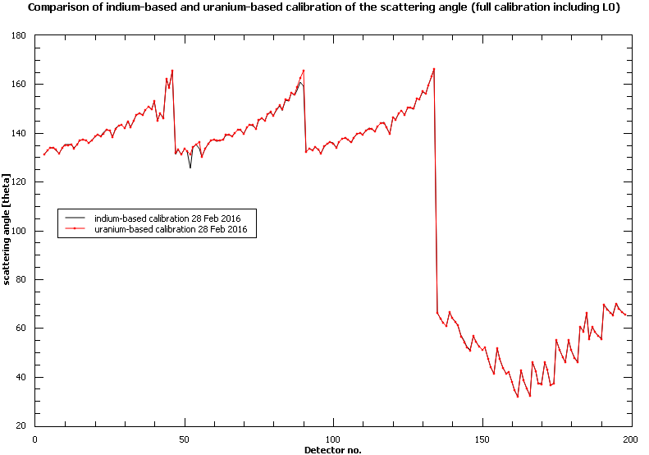

Slide 42
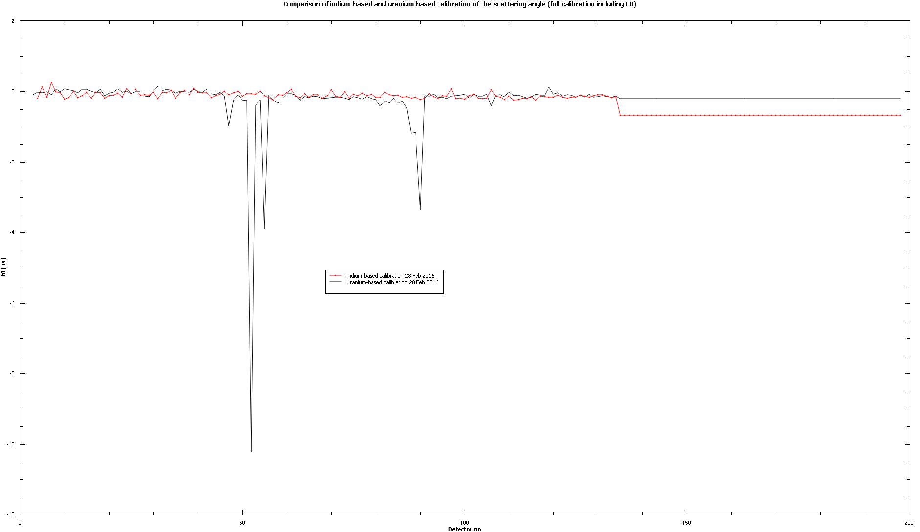

Slide 43
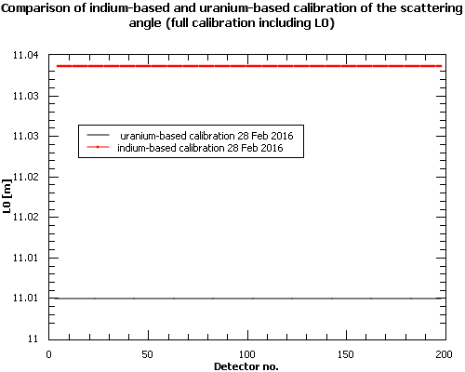

Slide 44
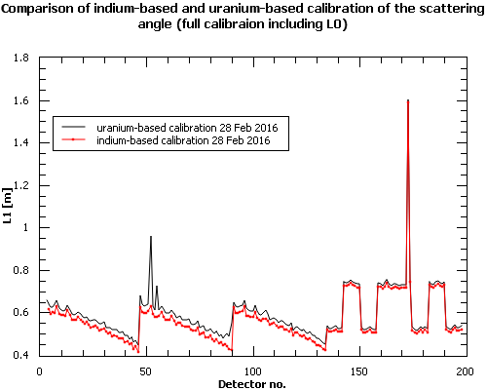

Slide 45
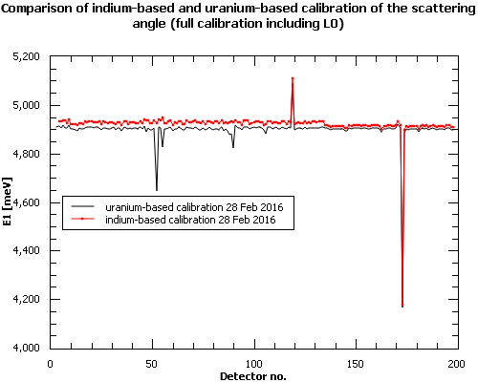

Slide 46
Comparison of uranium-based calibration
From June 2015 and February 2016

Slide 47
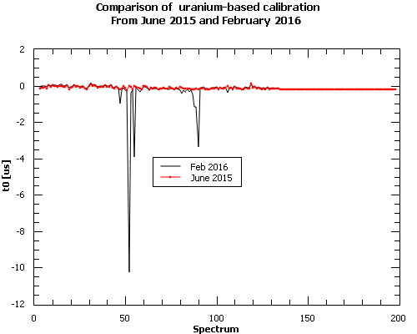

Slide 48
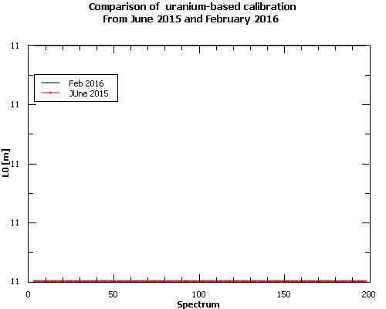

Slide 49
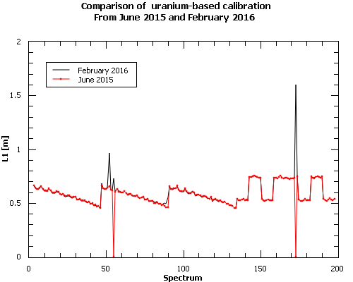

Slide 50
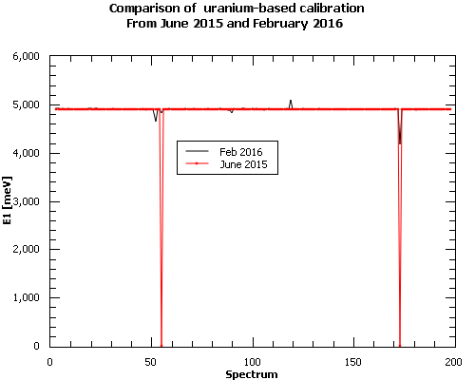

Slide 51
